Slide 1

1516
Lesson 8: Files, scope, refs, debugging

Slide 2
Topics
Files
Local vs. global scope
Object references
Debugging

Slide 3
Files
File handling refers to the process of opening a file with various permissions (e.g. for reading and writing, for reading only, etc…), reading and writing to the file, and closing it.
A typical pattern for working with files is:
1. open the file with a certain permission and assign a file handle file = open(“books.txt”, “r”)
2. read/write to the file handle string = file.read()
3. close the file file.close()

Slide 4
Files
Always close a file you open.
Failing to close a file that you opened can result in a variety of issues:
- a permanently-locked state (inaccessible for operations now)
- a corrupted file
- any writing may have gone uncommitted (so, no write actually happened).

Slide 5
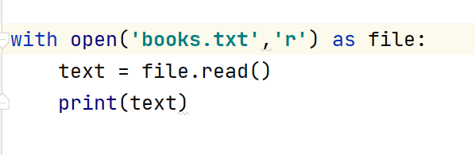
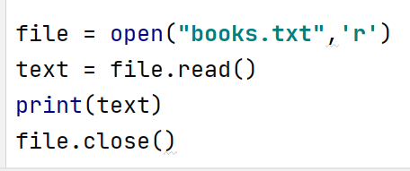
Files
Another way to open and close() a file is:
with open("books.txt", "r") as file :
#instructions of file processing are indented; use the file variable
The file is closed automatically once the flow of execution leaves the with block

Slide 6
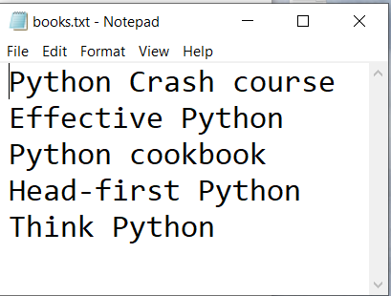
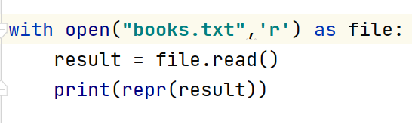
Files: Reading
One way to read from a file is by using the read() method
read() returns a string version of the entire file contents, including the "\n" at the end of each line
Example:
Output:

Slide 7
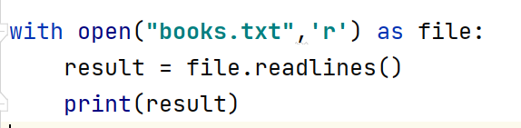
Files: Reading
Another way to read the content of a file is by using the file variable’s readlines() method
readlines() returns a list of all the file lines including the "\n" at the end of each line
Example:
Output:

Slide 8
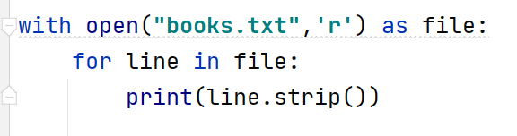
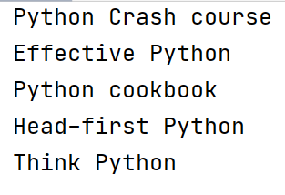
Files: Reading
If the file size is huge and there is not sufficient memory to read the whole file at once, a loop can be used to read the file one line at a time
Example:
Output:
The strip() method can be used to eliminate the "\n" character at the end of each line

Slide 9
Files: Reading
Let’s read the file and dump it into a list (one line in the file ➔ one element in a list):
f = open("books.txt", "r")
file_as_list = f.readlines()
f.close()
print("entire file is %s" % file_as_list)
Output:
entire file is ['harry potter\n', 'star wars\n', 'lord of the rings\n', 'python for everybody\n', 'the four-hour workweek\n', 'getting real']

Slide 10
Files: Reading
Let’s read the file and dump its entire contents into a single string (one file ➔ one string):
f = open("books.txt", "r")
file_as_string = f.read()
f.close()
print("entire file is %s" % file_as_string)
Output:
entire file is harry potter
star wars
lord of the rings
python for everybody
the four-hour workweek
getting real

Slide 11
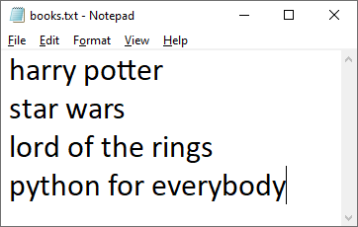
Files: Reading and Writing
Let’s create a file (or overwrite it if the file already exists), write data on four separate lines, then close the file.
f = open("books.txt", "w")
f.write("harry potter\nstar wars\nlord of the rings\npython for everybody\n")
f.close()
Before running the code
After running the code

Slide 12
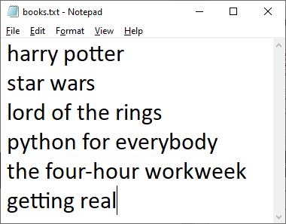
Files: Appending
Let’s open the file and append data (i.e. add to the end) on two more separate lines, then close the file.
f = open("books.txt", "a")
f.write("the four-hour workweek\ngetting real\n")
f.close()

Slide 13
Files: Modes
f = open("books.txt", "r")
The instruction above opens the file for reading only. The "r" is called the mode. Reading is the default mode, so in this case we could have omitted it and written f = open("books.txt") instead.
Other modes:
w writing; totally overwrites an existing file; creates file if it doesn’t exist already
x creates a file; if the file exists already an error is given
a appending; writes to the end of an existing file; creates file if it doesn’t exist already
+ opens a file for reading and/or writing (i.e. "updating")

Slide 14
Variable Scope: Local Variable
Scope – the visibility of a function or variable in a program
"Function scope" (aka "Local scope"): Variables defined inside a function have this scope. They are usable only within the function itself.
def get_full_name(first_name, last_name):
# full_name is a local variable whose scope is the function
full_name = first_name.title() + ' ' + last_name.title()
return full_name
print(get_full_name('tiger', 'woods')) # Tiger Woods
print(full_name) #NameError: name 'full_name" is not defined

Slide 15
Variable Scope: Writing to Globals
The keyword global must be used to change the value of a global variable from inside of a function.
first_name = 'tiger’
def change_first_name():
first_name = 'jason’ # syntax error: cannot change global variable from inside a function!
change_first_name()
print(first_name) # tiger NOT CHANGED

Slide 16
Variable Scope: Writing to Globals
The keyword global must be used to change the value of a global variable inside of a function.
first_name = 'tiger’
def change_first_name():
global first_name
first_name = 'jason’ # ok; changed
change_first_name()
print(first_name) # jason CHANGED

Slide 17
References
Arguments to functions are passed by object reference, a concept known in Python as pass-by-assignment.
When a function is called, new local variables are created in the function's local namespace by binding the names in the parameter list to the passed arguments.
def increment(counter):
counter = counter + 1 # global counter would have changed it
counter = 7
increment(counter)
print counter # counter is still 7 # NOT CHANGED

Slide 18
References
When a function modifies a parameter, whether or not that modification is seen outside the scope of the function depends on the mutability of the argument object.
If the object is immutable, such as a string or integer, then the modification is limited to inside the function. Any modification to an immutable object results in the creation of a new object in the function's local scope, thus leaving the original argument object unchanged.
If the object is mutable, then in-place modification of the object can be seen outside the scope of the function. Any operation like adding elements to a container or sorting a list that is performed within a function will also affect any other variables in the program that reference the same object.
def modify(my_list):
my_list[1] = 99
my_list = [10, 20, 30]
modify(my_list)
print(my_list) # my_list now is [10, 99, 30] # THE LIST IS CHANGED

Slide 19
Arguments
'
def format(first_name, last_name):
full_name = first_name.upper() + " " + last_name.lower()
return full_name
print(format("tiger", "woods")) # TIGER woods
print(format(last_name="woods", first_name="tiger")) # TIGER woods
print(format(first_name="bill", last_name="gates")) # BILL gates

Slide 20
PyCharm Debugger
Four important components that are useful in this (and all) debuggers:
1. watch window: see what the program is storing inside its variables
2. stack trace: see where the program execution is coming from and going to
3. step: one at a time, execute (and/or skip) individual instructions
4. breakpoint: freeze / pause the program at certain points
We can put a “breakpoint” in our code and then Debug it. The program will run until it reaches the breakpoint and then pause. Put a breakpoint at any executable line of code by clicking in the margin to the right of the line number (see next slide).

Slide 21
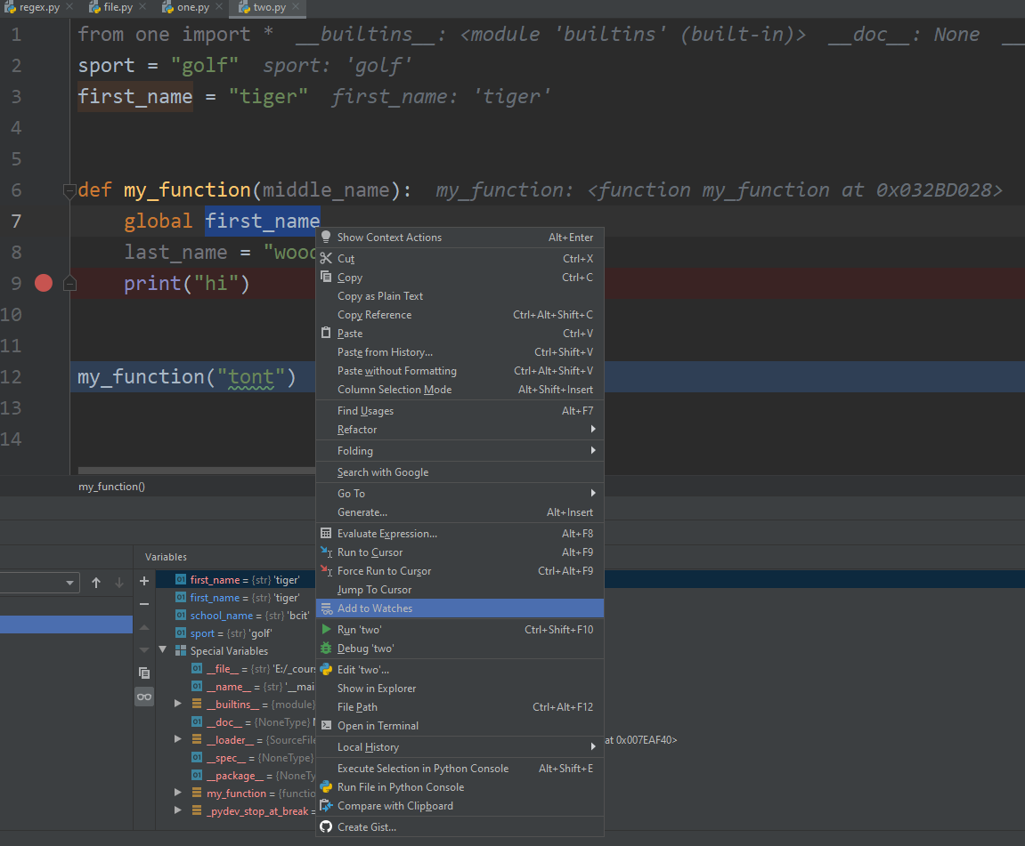
Watch
Watch Window:
watch what the two.py script is storing inside its variables:
Instead of Run ‘two’, highlight variables and select Add to Watches
Then select Debug ‘two’
Now we see the values of the variables in the Debugger console at the bottom of the IDE.

Slide 22
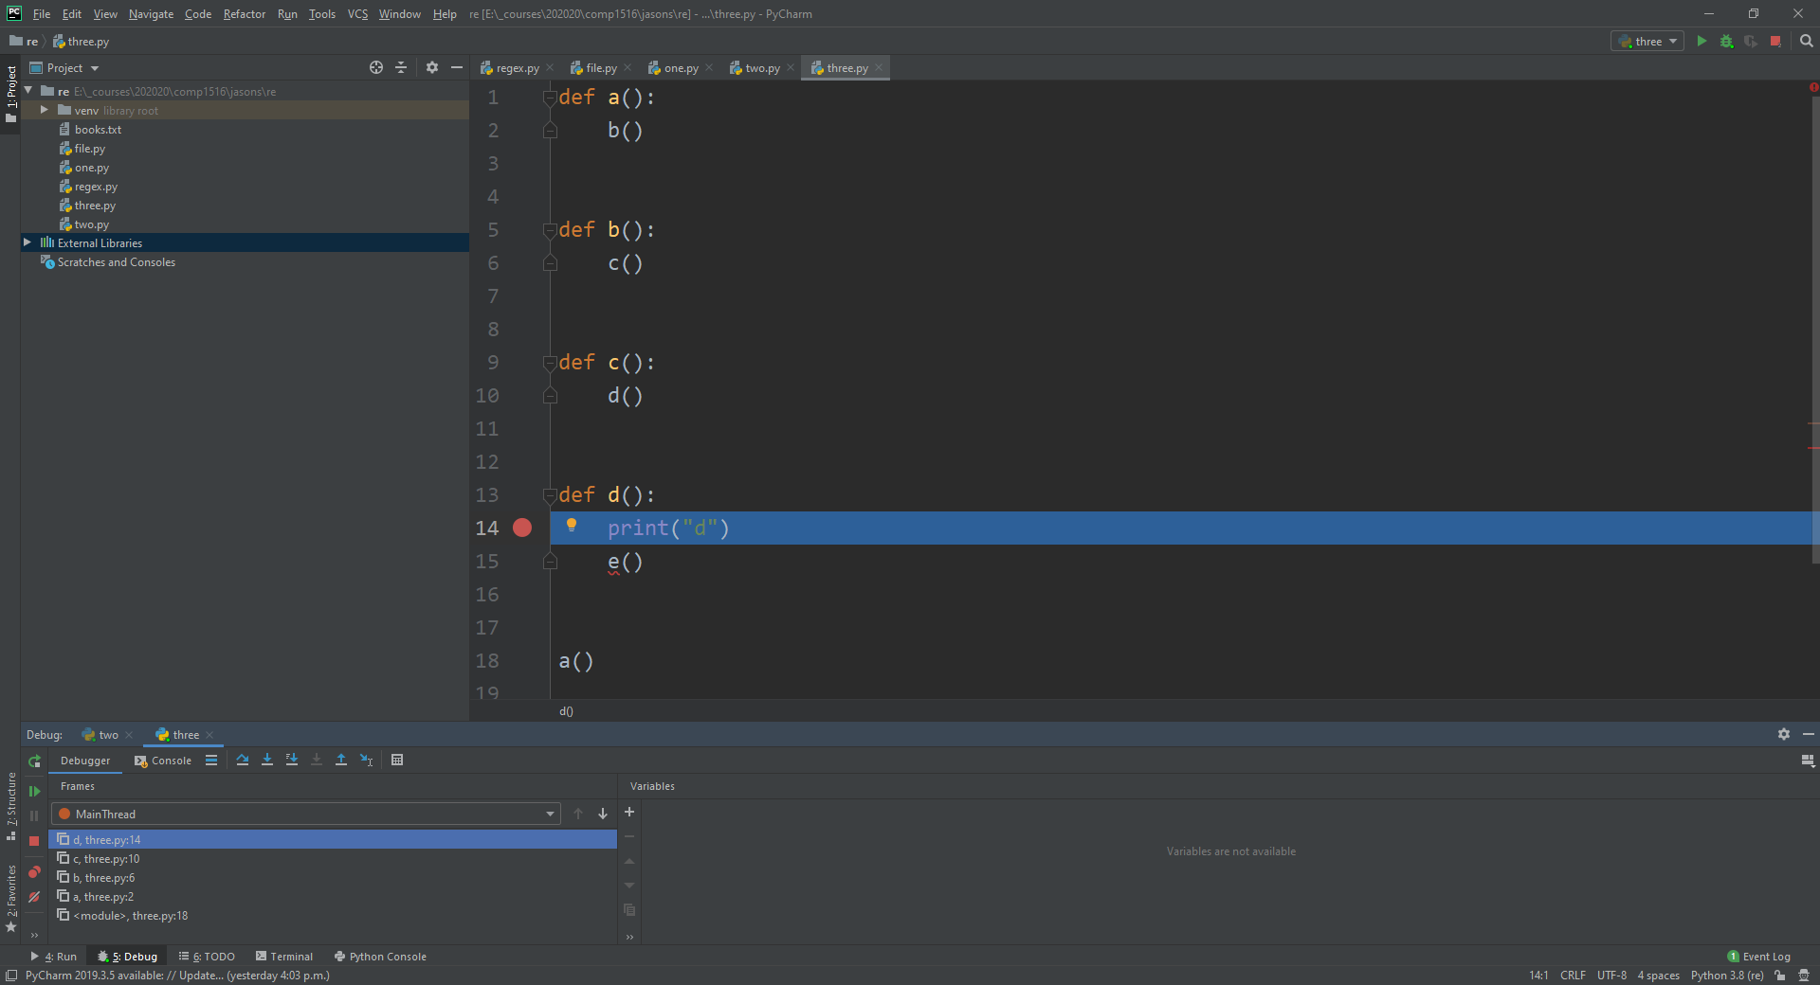
Stack Trace
Stack Trace:
I put a breakpoint on line 14, inside the d() function, and the stack trace at the bottom- right of the debugger console shows that d() is on the top of the stack (imagine a stack of plates), and we can see that d() was called from c() which was called from b() which was called from a()…and we can see that none of these four functions are yet closed (finished). We can see how we got to d().

Slide 23
Step
Step:
Once your program has stopped at a breakpoint, we can choose to step into that line (for instance, if the line is a function call), or step over it one “line” at a time, by using the little arrows at the top of the debugging console.

